Slide 1
WELCOME TO MODULE 6
ADVANCE SYSTEM ADMINISTRATION

Slide 2
What we will learn…..
Chapter I- Role vs Features
Chapter II- Adding Roles And Features
Chapter III- What is domain controller
Chapter IV- Domain Controller and Active Directory
Chapter V- Active Directory Prerequisites
Chapter VI- What is DNS
Chapter VII- Active Directory Installation
Chapter VIII- Active Directory Users and Computers
Chapter IX- Active Directory User Account Management
Chapter x- Installing Windows client
Chapter XI- Joining the domain from windows 7 & 10
Chapter XI- Active Directory “Administrative Center”
Chapter XII- Active Directory “Domain and Trust”
Chapter XIII- Active Directory “ Module for Windows Powershell”
Chapter XIV- Active Directory “Site and Services”
Chapter XV- Active Directory Group Policy Management
Chapter XVI- DNS Administration
Chapter XVII- WebServer (IIS) Installation

Slide 3
Chapter I- ROLES VS FEATURES
Roles
A server role is a set of software programs that, when they are installed and properly configured, lets a computer perform a specific function for multiples users or other computers within a network.
Roles services
Are software programs that provide the functionality of a role. When you install a role, you can choose which services the role provides for other users and computers in your enterprise.
Features
Are software programs that, although they are not directly part of roles or augment the functionality of one or more role, or improve the functionality of the server, regardless of which roles are installed.

Slide 4
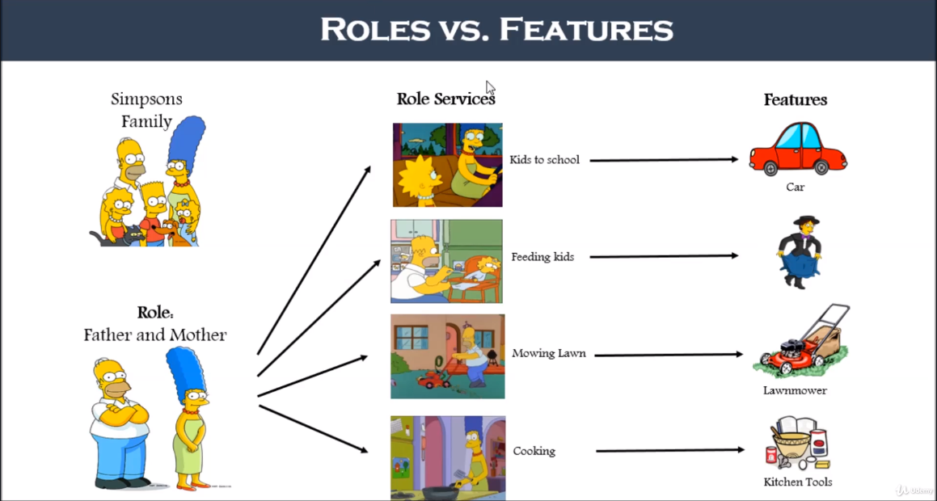
Roles vs Features

Slide 5
Chapter II- Adding Roles and Features
When adding a role it may not requires service role or features.
Service Roles are directly associated with roles and can’t be installed without roles.
When adding features it may or may not require service roles.
When adding features it does not require roles.

Slide 6
Chapter III- Domain Controller
Domain is an area of territory owned or controlled by a ruler or government
Kingdom of resources
Domain Controller Controls major group services such as:
User Activation (AD)
DNS
Print Services
Files System Separation
Windows Time Service
DHCP

Slide 7
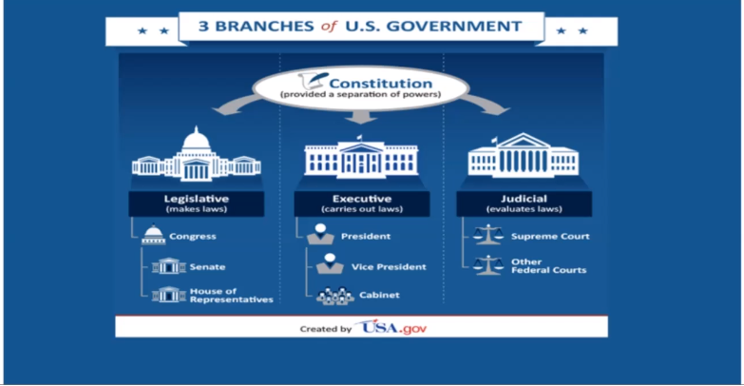

Slide 8
Chapter IV- Domain Controller and Active directory
Domain Controller (DC) is the main service that serves Active directory (AD) Service.
Active directory is a directory service which allows user to authenticate logins, login to the clients.

Slide 9
1- Domain Controller Installation
Domain Controller cannot be installed without a role
e.g. you can open a company but it is useless if it does not provide any products or services.
You will need a role service to install domain controller

Slide 10
2- WHAT IS ACTIVE DIRECTORY
Active Directory is one of the primary service role of a domain controller
It stores information about objects on the network and make this information available to users and network administrators. AD DS uses domain controllers to give network users access to permitted resources anywhere on the network through a single logon process.

Slide 11
Chapter V- Active Directory Prerequisites
DNS
Static IP ADDRESS
DOMAIN CONTROLLER= mylabdc.local
NETBIOS DOMAIN NAME= lab

Slide 12
Chapter VI- What is DNS
Domain Name Service
Domain Name system or Server
DNS is actually resolved the HOSTNAME to IP ADDRESS
DNS also resolves HOSTNAME to IP ADDRESS
It also resolves HOSTNAME to HOSTNAME (Alias or CNAME)
Cache memory is a chip-based computer component that makes retrieving data from the computer's memory more efficient. It acts as a temporary storage area ...

Slide 13
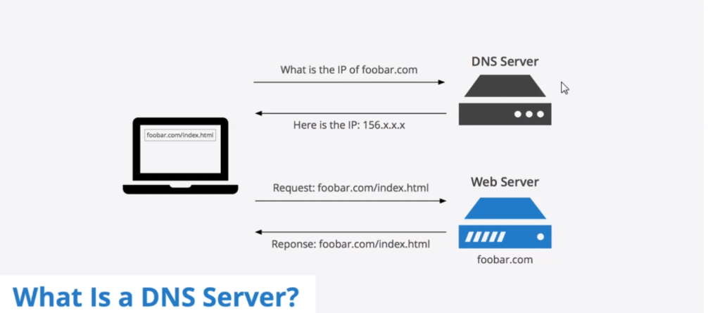
DNS

Slide 14
Chapter VII- Active Directory Installation
DNS
STATIC IP ADDRESS= 10.0.0.25
DOMAIN CONTROLLER NAME= mylabdc.local
NETBIOS Domaine name= lab
NSLookup is a primary diagnostic tool for debugging a Domain Name System (DNS) architecture. You can use it to display any resource record on ...

Slide 15
What is the purpose of additional domain controller?
Additional AD domain controller is used to balance the load among existing domain controllers. It also provides fault-tolerance that in case primary AD DC is down, additional AD DC can be used for authentications without any business discontinuity.
If your one Domain Controller goes down users will be unable to log in to the domain, access resources in the domain, won't have access to their Exchange mailbox, etc…
Additional AD domain controller is used to balance the load among existing domain controllers. It also provides fault-tolerance that in case primary AD DC is down, additional AD DC can be used for authentications without any business discontinuity.

Slide 16
Chapter VIII- Active Directory Users and Computers
Organization unit
An organizational unit (OU) is a subdivision within an Active Directory into which you can place users, groups, computers and others organizational units.
Objects
Are like Users, Groups, Contacts, Shared Folder, Printers etc.….
Attributes
Objects have attributes that define and describe them. Form example, the attributes of a user object might include the user’s name, e-mail address, and phone number.

Slide 17
Active Directory “Additional Information”
Forest in AD
Forest is used to define an assembly of AD domains that share a single schema for the AD. All DC’s in the forest share this schema and is replicated in a hierarchical fashion among them.
AD runs on LDAP(lightweight Directory Access Protocol) protocol.
A lot of people mistake LDAP as an active directory. Remember that LDAP is a protocol uses for directory services. There are different directory services e.g: Active directory on windows and OPENLDAP on Linux.
SYSVOL
The sysVOL keeps the server’s copy of the domain’s public files. The contents such as users, group policy, etc. of the sysVOL folder are replicated to all domain controllers in the domain.
AD Database
AD database is saved into in C:\WINDOWS\NTDS
Component of AD includes
Logical structure, Trees, Forest and Domains or OU
Physical structure, Domain Controller and Sites.

Slide 18
Chapter VIII- Active Directory Users and Computers
AD User Account Management
Managing Active Directory is one of the main responsibility of system administrator.
What we will learn…….
Creating Organization Unit
HR, IT, FINANCE etc.
An organizational unit (OU) is a subdivision within an Active Directory into which you can place users, groups, computers, and other organizational units. You can create organizational units to mirror your organization's functional or business structure.
Settings Sub-OU
IT= System, Network, Developer, Devops Etc.
FINANCE= Accounting, Taxation etc.
You can create a sub OU within the main OU.
We can create group within Sub OU e.g. Systems= Windows, Linux, VMWare.
Create a User e.g. Windows= James, Sean etc.
If you are working for a multi national company and you have office everywhere (Europe, India, Africa) each location will have an OU and Domain Controller then all Domains controller will be under the same Forest.

Slide 19
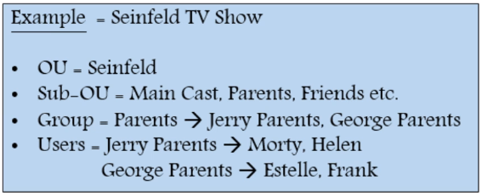

Slide 20
Chapter IX- Active Directory User Account Management
What will learn here……..
How to create an OU(organization Unit)
How to create a Sub OU
How to create Users
How to add Users into a Group

Slide 21
Chapter x- Installing Windows client
Download windows 10 client in Microsoft website
Create a virtual machine and install windows 10 on it.
Change the hostname of the client machine.

Slide 22
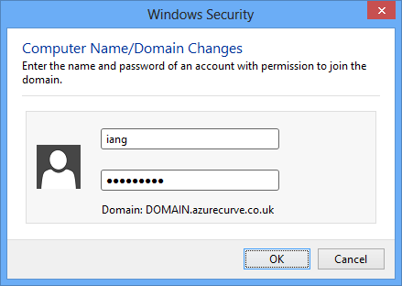
Chapter XI- Joining the domain from windows 7 & 10

Slide 23
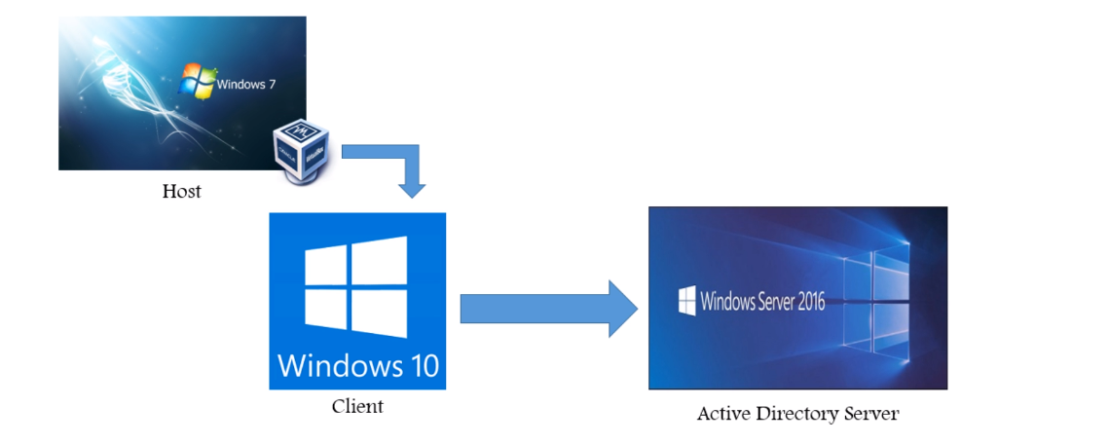
Chapter XI- Joining the domain from windows 7 & 10

Slide 24
PREREQUISITES FOR JOINING THE DOMAIN
AD should be up and running with static IP
Client can reach the active directory.
A User account should exist on active directory.

Slide 25
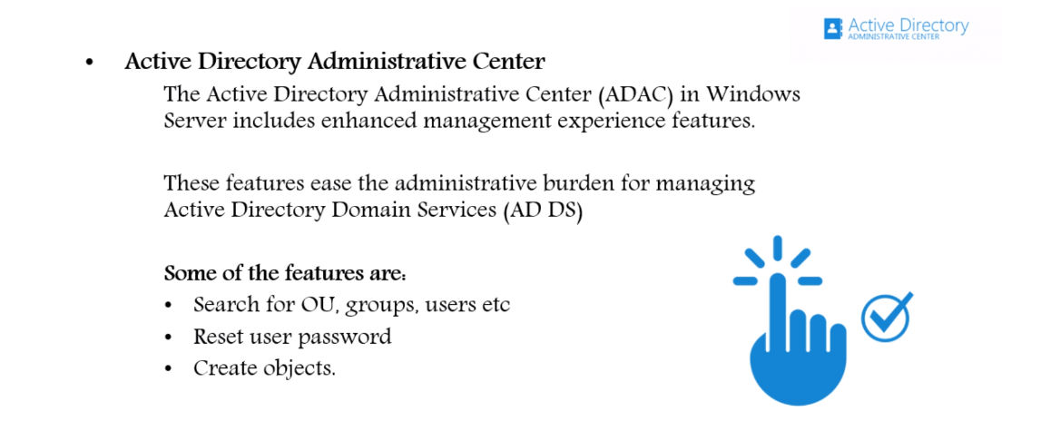
Chapter XI- Active Directory “Administrative Center”

Slide 26
Chapter XII- Active Directory “Domain and Trust”
The active directory domains and trust console is a standard Microsoft management console (MMC) with the usual layout and elements. The left pane shows the domain list and the right pan shows objects, such as trust, associated with the selected domain.
Two of main features are:
Manage Domain trust = There are several tasks you can perform with the console, including verifying or removing a trust and creating shortcut, realm, and external trusts. These trusts task will be explain later.
Manage forest trust = you can accomplish several tasks related to forest trust, including creating a forest trust and managing routing for specific names suffixes

Slide 27
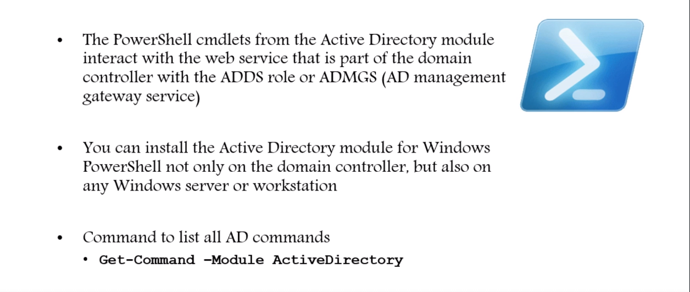
Chapter XIII- Active Directory “ Module for Windows Powershell”

Slide 28
INRODUCTION TO POWERSHELL
$PSVersionTable: will display powershell version.
Invoke-WebRequest: Download a file or app from the internet
Get-commands will display all available commands
New-Aduser to create a new user
Get-Hel for help
Update-Help
Get-Help Get-Process –online
import-module ActiveDirectory
Powershell is also defined as command line management and administration environment.

Slide 29
WSL
Windows Subsystem for Linux is a compatibility layer for running Linux binary executables natively on Windows 10, Windows 11, and Windows Server 2019. In May 2019, WSL 2 was announced, introducing important changes such as a real Linux kernel, through a subset of Hyper-V feature.
WSL provides a layer for mapping Windows kernel system calls to Linux kernel system calls. ... Instead of using a VM or container, WSL virtualizes a Linux kernel interface on top of the Windows kernel. This means that running WSL only requires a minimal amount of RAM.

Slide 30
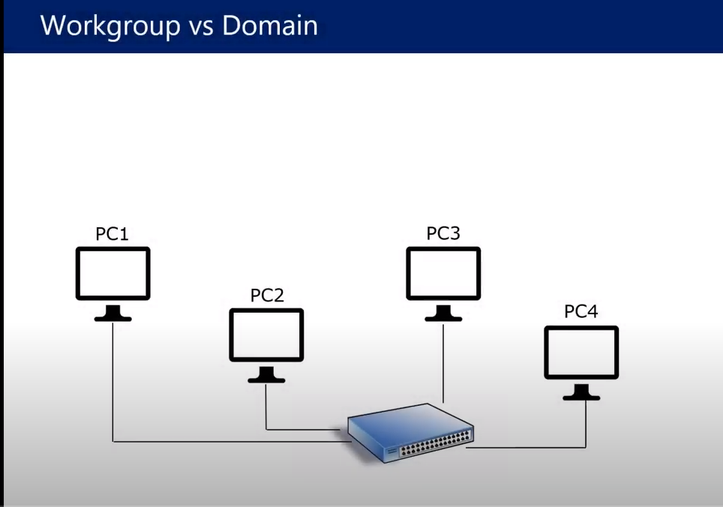
WORKGROUP VS DOMAIN

Slide 31
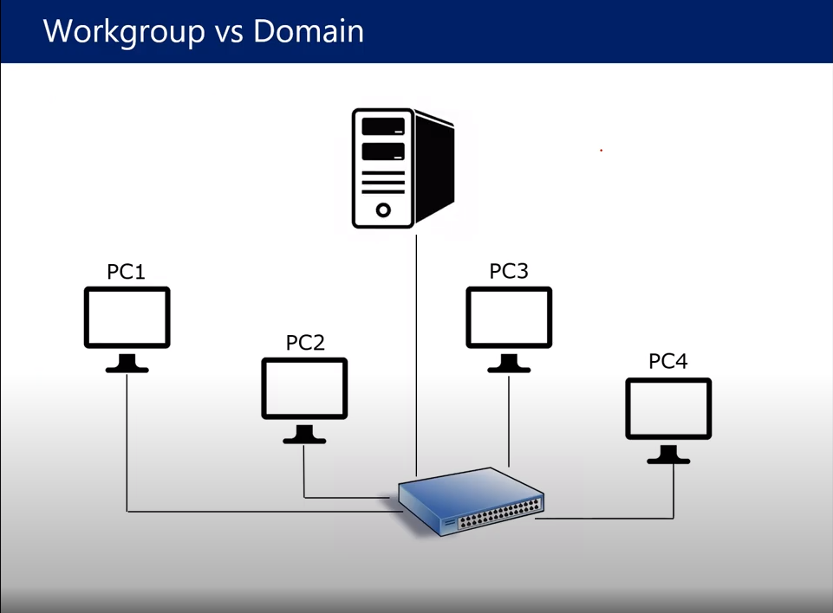

Slide 32
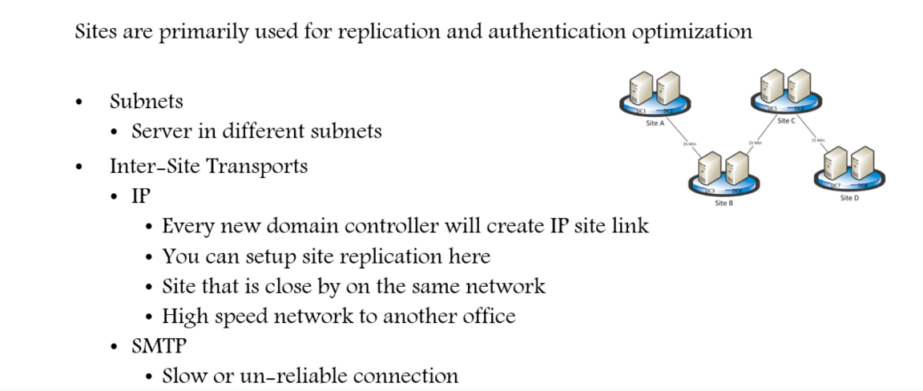
Chapter XIV- Active Directory “Site and Services”

Slide 33
Why do you need to create site and services ?
From a user point view which domain controller do I actually if I am a user in Seattle ?
If a user logon in Seattle office we what him to talk to a DC in Seattle.
Services Localization, you will always use local active directory first in your physical location before you cross a wired link and by pass a DC in your location and go to Washington or Phoenix to authenticate
Managed Replication, that means every domain controller within the same active directory domain will be a replica of each other.

Slide 34
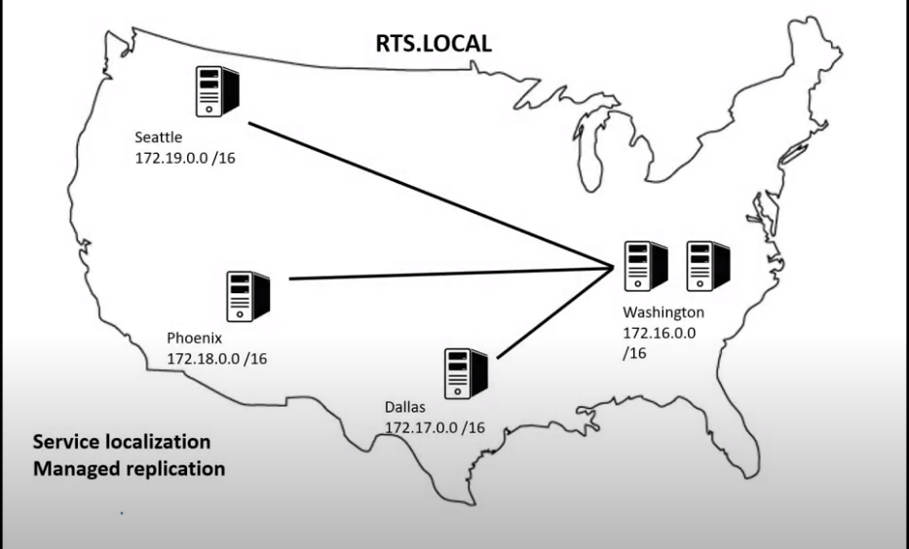
PRATICE SCENARIO

Slide 35
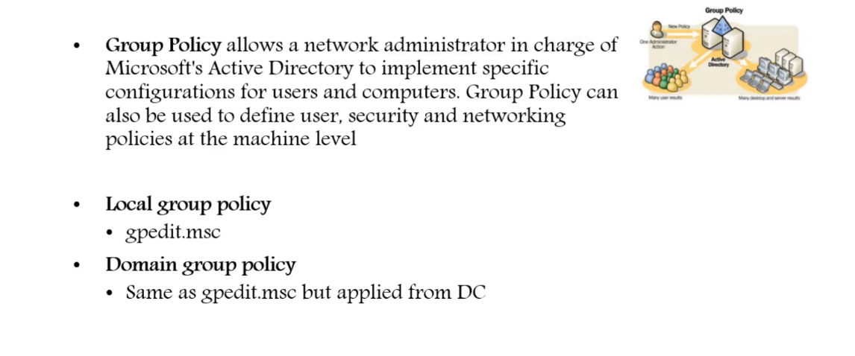
Chapter XV- Active Directory Group Policy Management

Slide 36
Chapter XVI- DNS Administration
DNS records are instructions that live in authoritative DNS servers and provide information about a domain including what IP address is associated with that domain and how to handle requests for that domain. These records consist of a series of text files written in what is known as DNS syntax. DNS syntax is just a string of characters used as commands that tell the DNS server what to do. All DNS records also have a ‘TTL’, which stands for time-to-live, and indicates how often a DNS server will refresh that record.
Type of DNS records
A record (host ipv4) that’s resolution for hostname to ip address.
AAAA record (host ipv6) ipv6 is an enhance version of ipsec
PTR record (reverse) it will create a resolution for ip address to hostname.
CNAME record (Alias) Forwards one domain or subdomain to another domain, does NOT provide an IP address.
MX record - Directs mail to an email server.

Slide 37
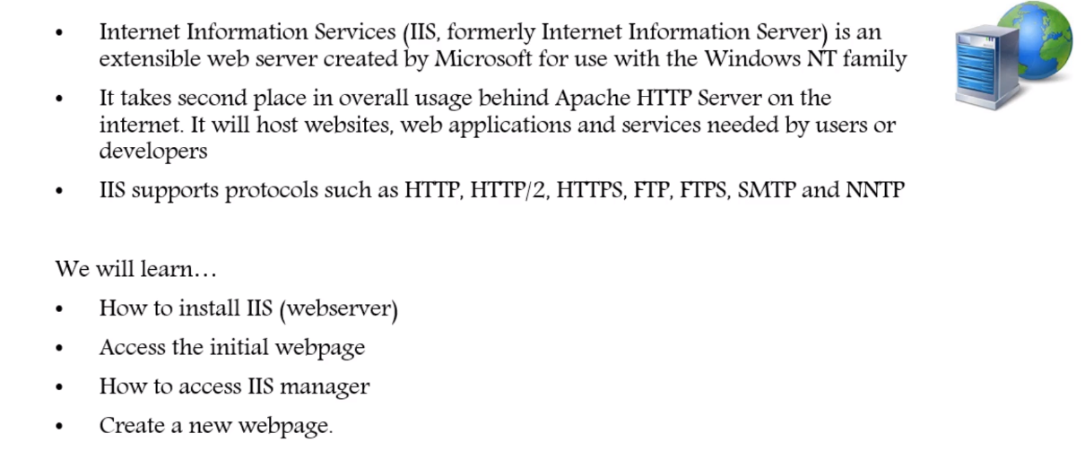
Chapter XVII- WebServer (IIS) Installation
A web server is server software, or a system of one or more computers dedicated to running this software, that can satisfy client HTTP requests on the public World Wide Web or also on private LANs and WANs
A web server delivers content for a website to a client that requests it, like a web browser. A web server communicates with a web browser using HTTP.

Slide 38
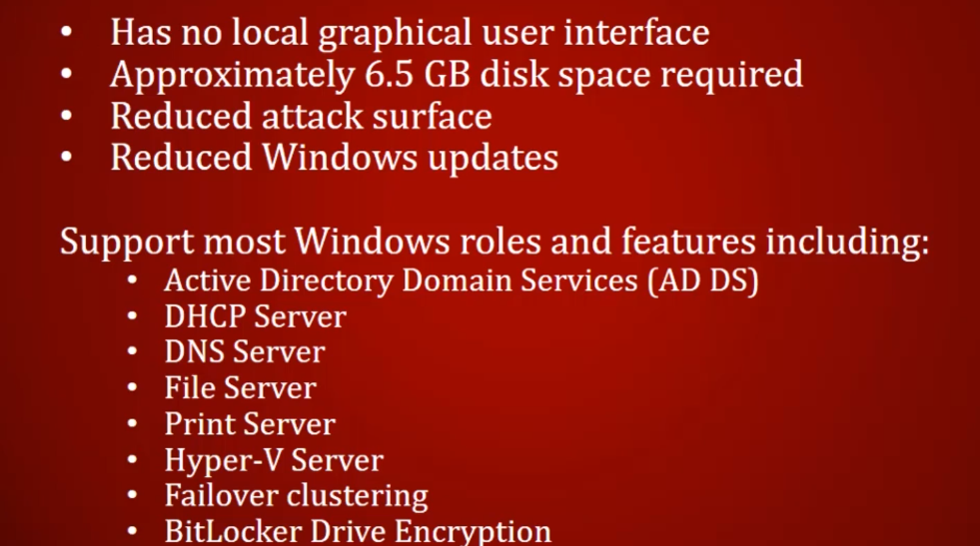
Chapter XVIII- SERVER CORE OPERATING SYSTEM
Windows Server Core is a minimal installation option for the Windows Server operating system (OS) that has no GUI and only includes the components required to perform server roles and run applications.

Slide 39
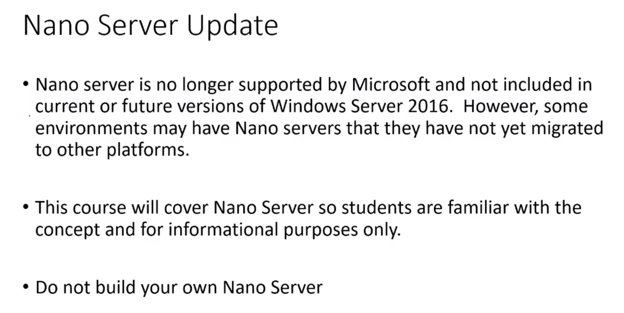
Chapter XIX- NANO SERVER

